Slide 1
Gerardium Rush
Group Sphalerite
24/05/2024

Slide 2
Overview
Genetic algorithm
2) Circuit
3) Model Analysis
4) Further improvements

Slide 3
Software development

Slide 4
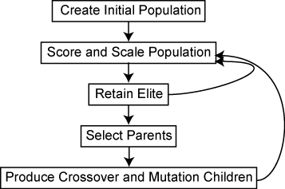
Genetic Algorithm
Create initial population: Randomly generate NumPopulation initial populations and use the Validity function to check if the generated individual is valid. If it is not valid, regenerate the individual until NumPopulation is reached.
Score and Scale Population: If the individual is valid, call Evaluate_Circuit function to evaluate the fitness of it. Then sort the individuals in the generation by fitness.
Retain Elite: The first NumPopulation - NumOffspring individuals remain unchanged into next generation.

Slide 5
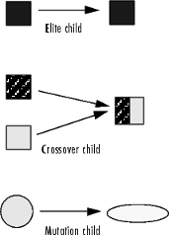
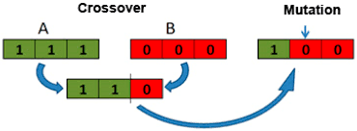
Genetic Algorithm :
Select Parents: Only the NumParents of individuals with the highest fitness in last generation were selected as parents into the next generation. Two of them were randomly selected to generate the new NumOffspring offspring.
Produce Crossover: NumCross crossovers are selected for gene exchange to generate a new offspring. Crossover occurs based on a predetermined crossover probability.
Mutate Substitution: Mutation operation on the newly generated offspring is achieved by randomly selecting a gene position and replacing it with a new random valid value, the mutation occurs depending on the mutationRate.

Slide 6
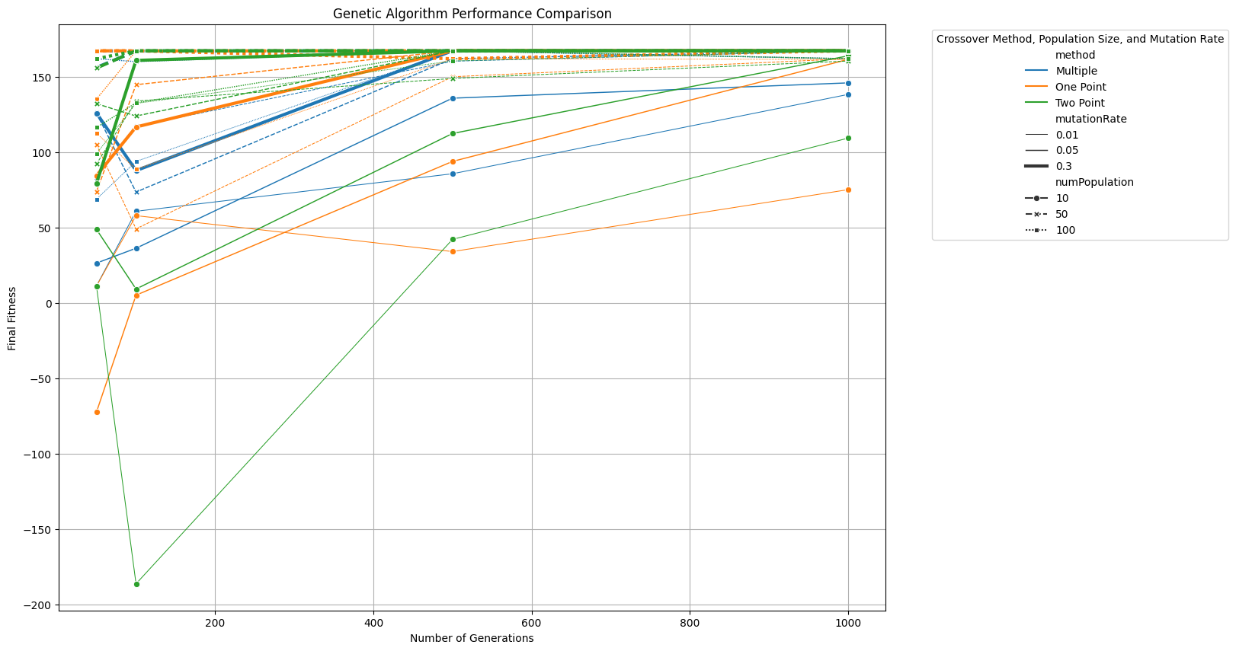
Genetic Algorithm :
Single-point Crossover:Genes from the beginning to the crossover point are copied from one parent, and the remaining genes are copied from the other parent.
Two-point Crossover: Genes between the two points are swapped between the parents.
Multi-point Crossover:Genes between each pair of points are alternately copied from parents. More diverse exploration.
Uniform: Each gene is independently chosen from either parent with a 50% probability. More randomness.

Slide 7
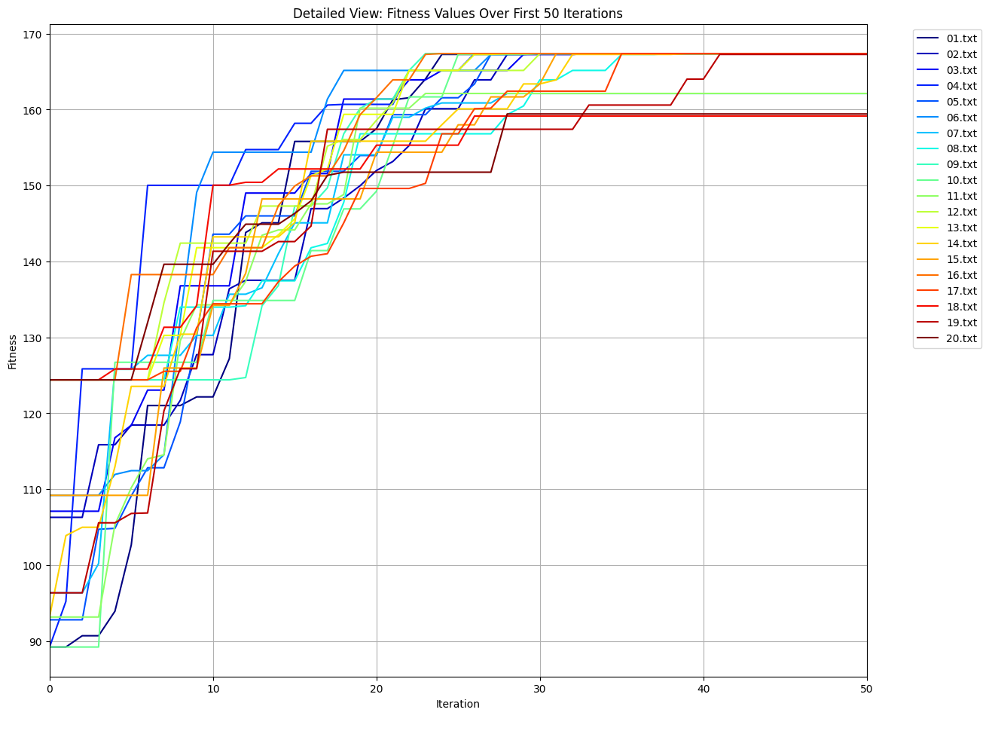
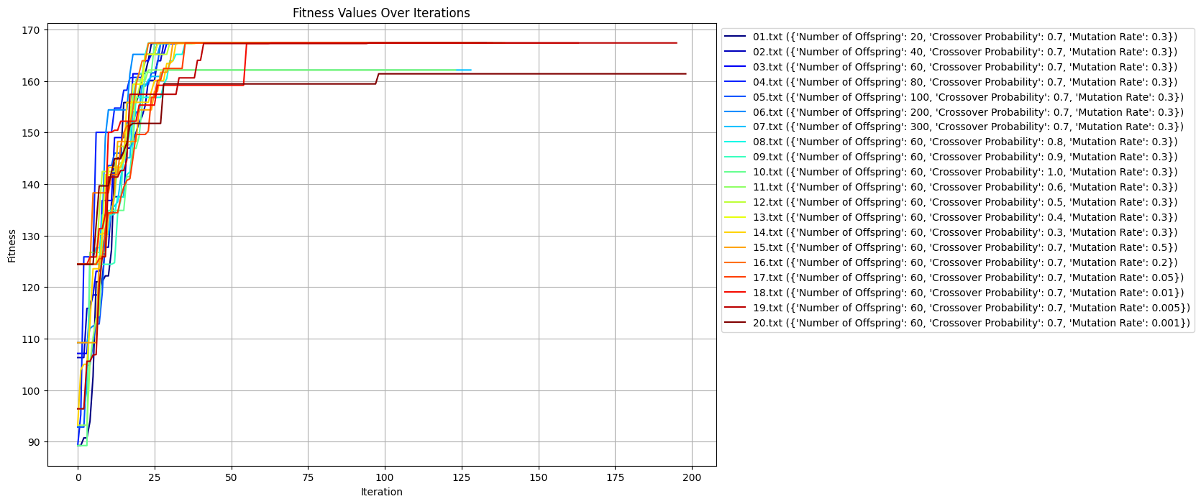
Parameters tuning

Slide 8
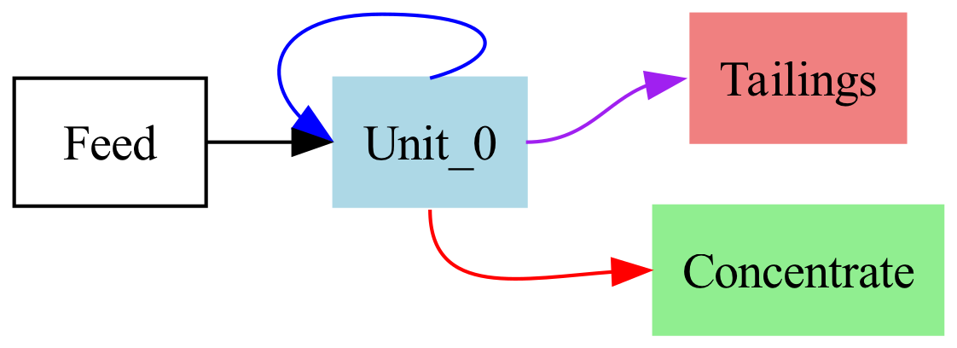
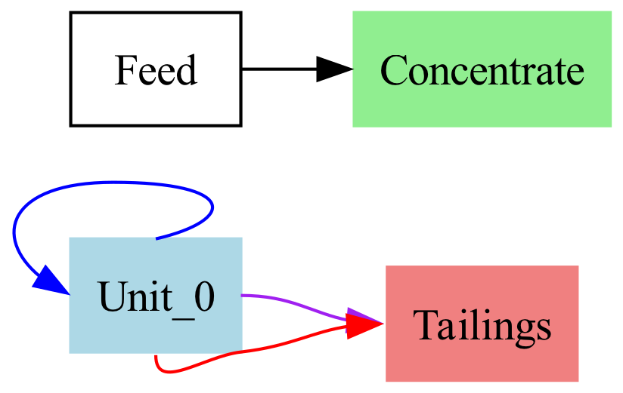
Validity Check
Invalid samples
Self-Recycle：
Explanation: Self-recycling is not allowed as it leads to invalid results. The unit has a feedback loop to itself.
· Disconnected Unit:
Explanation: Every unit must be part of the network starting from the feed to ensure accessibility. In this gragh, not all units are connected from the feed.

Slide 9
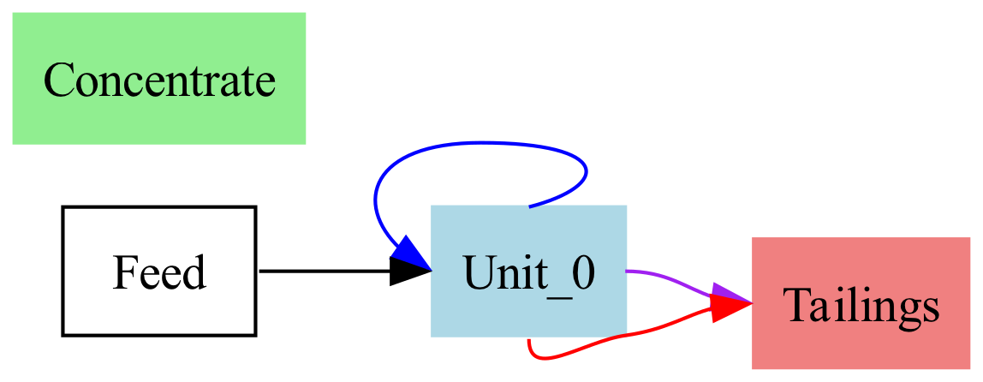
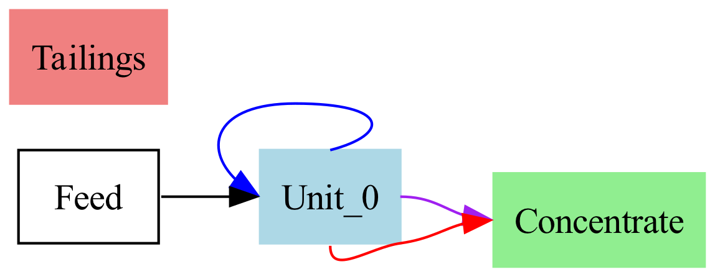
Validity Check
Invalid samples
Same Destination for All Streams :
Explanation: Units should distribute outputs to different destinations to ensure valid separation.
Here, all streams (concentrate, intermediate,
and tailings) point to the same unit.
No Route to All Streams:
Explanation: Each unit must have paths to both outlet streams for proper mass balance. Here the unit does not have routes to both concentrate and tailings streams.

Slide 10
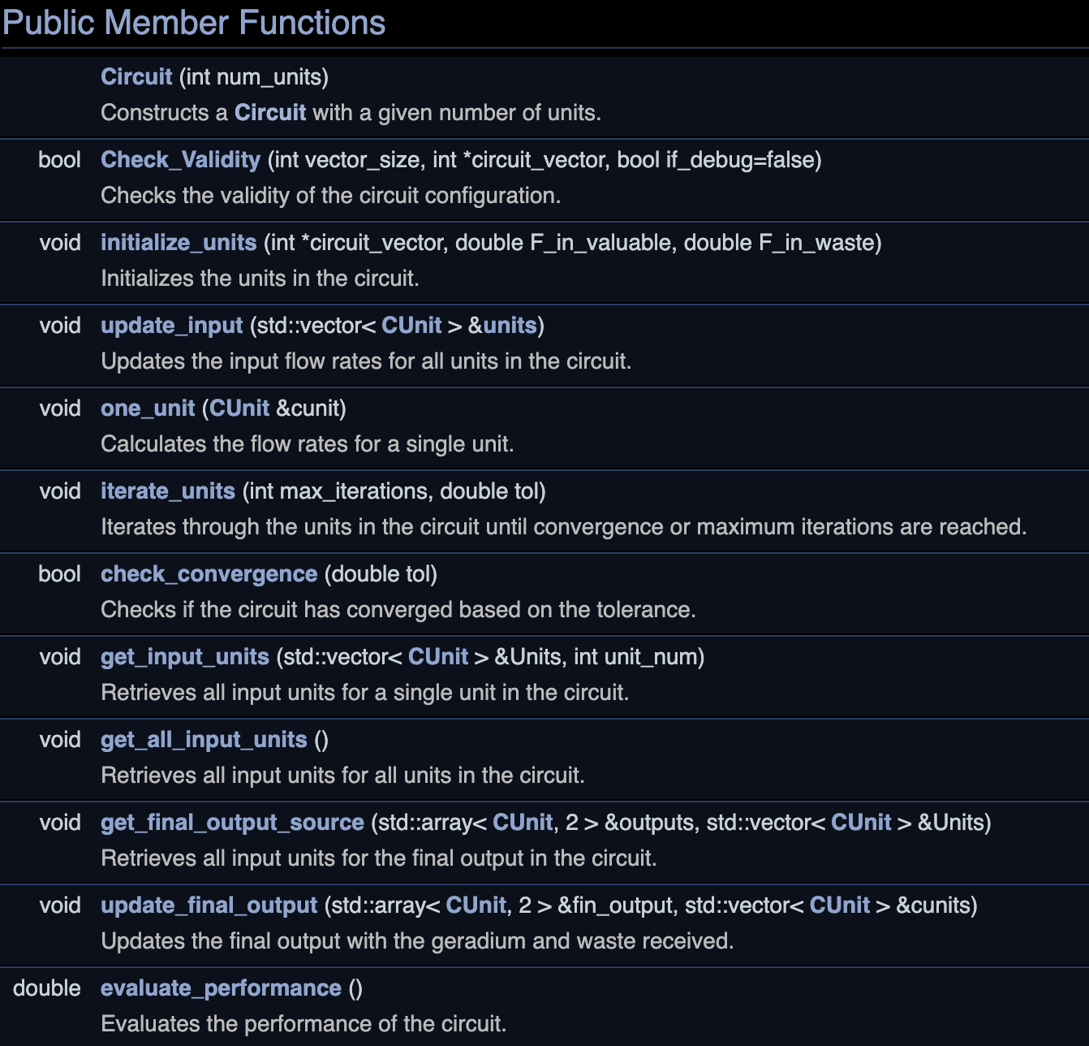
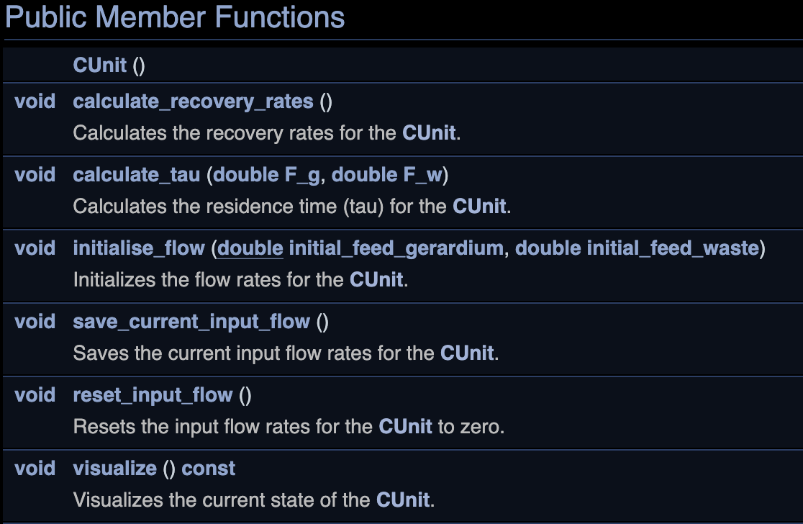
Circuit Modelling
The algorithm – CCircuit and CUnit

Slide 11
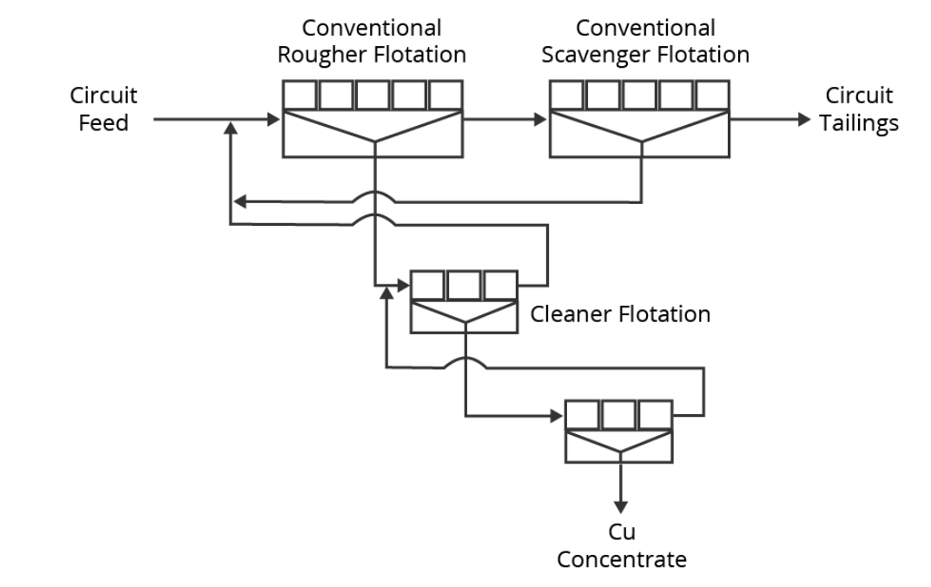
Iteration in units: Circuit
Starts a loop with a maximum number of iterations of max_iterations.
Get number of unit.
At the first iteration, the initial feed is used.
Save the current outstream as the next input.
Initialise the feed flow for the first cell and update the input flow for all cells.
Update the flow rate of the cells.
Iterate again and again.
Check for convergence and exit the loop if it converges, otherwise continue the iteration.

Slide 12
CSimulator
Units: Used to store individual units in the circuit.
Initialize_units:
initial_feed_gerardium：initialize the flow of gerardium
initial_feed_waste：initialize the waste
circuit.initialize_units：initialize the units and the connection
circuit.iterate_units: performs iterative calculations, adjusts and calculates the flow distribution of the units in the circuit until the convergence condition or the maximum number of iterations is reached.
Evaluate_Performance.
Economic benefit：
100*valuable gerardium-750*waste

Slide 13
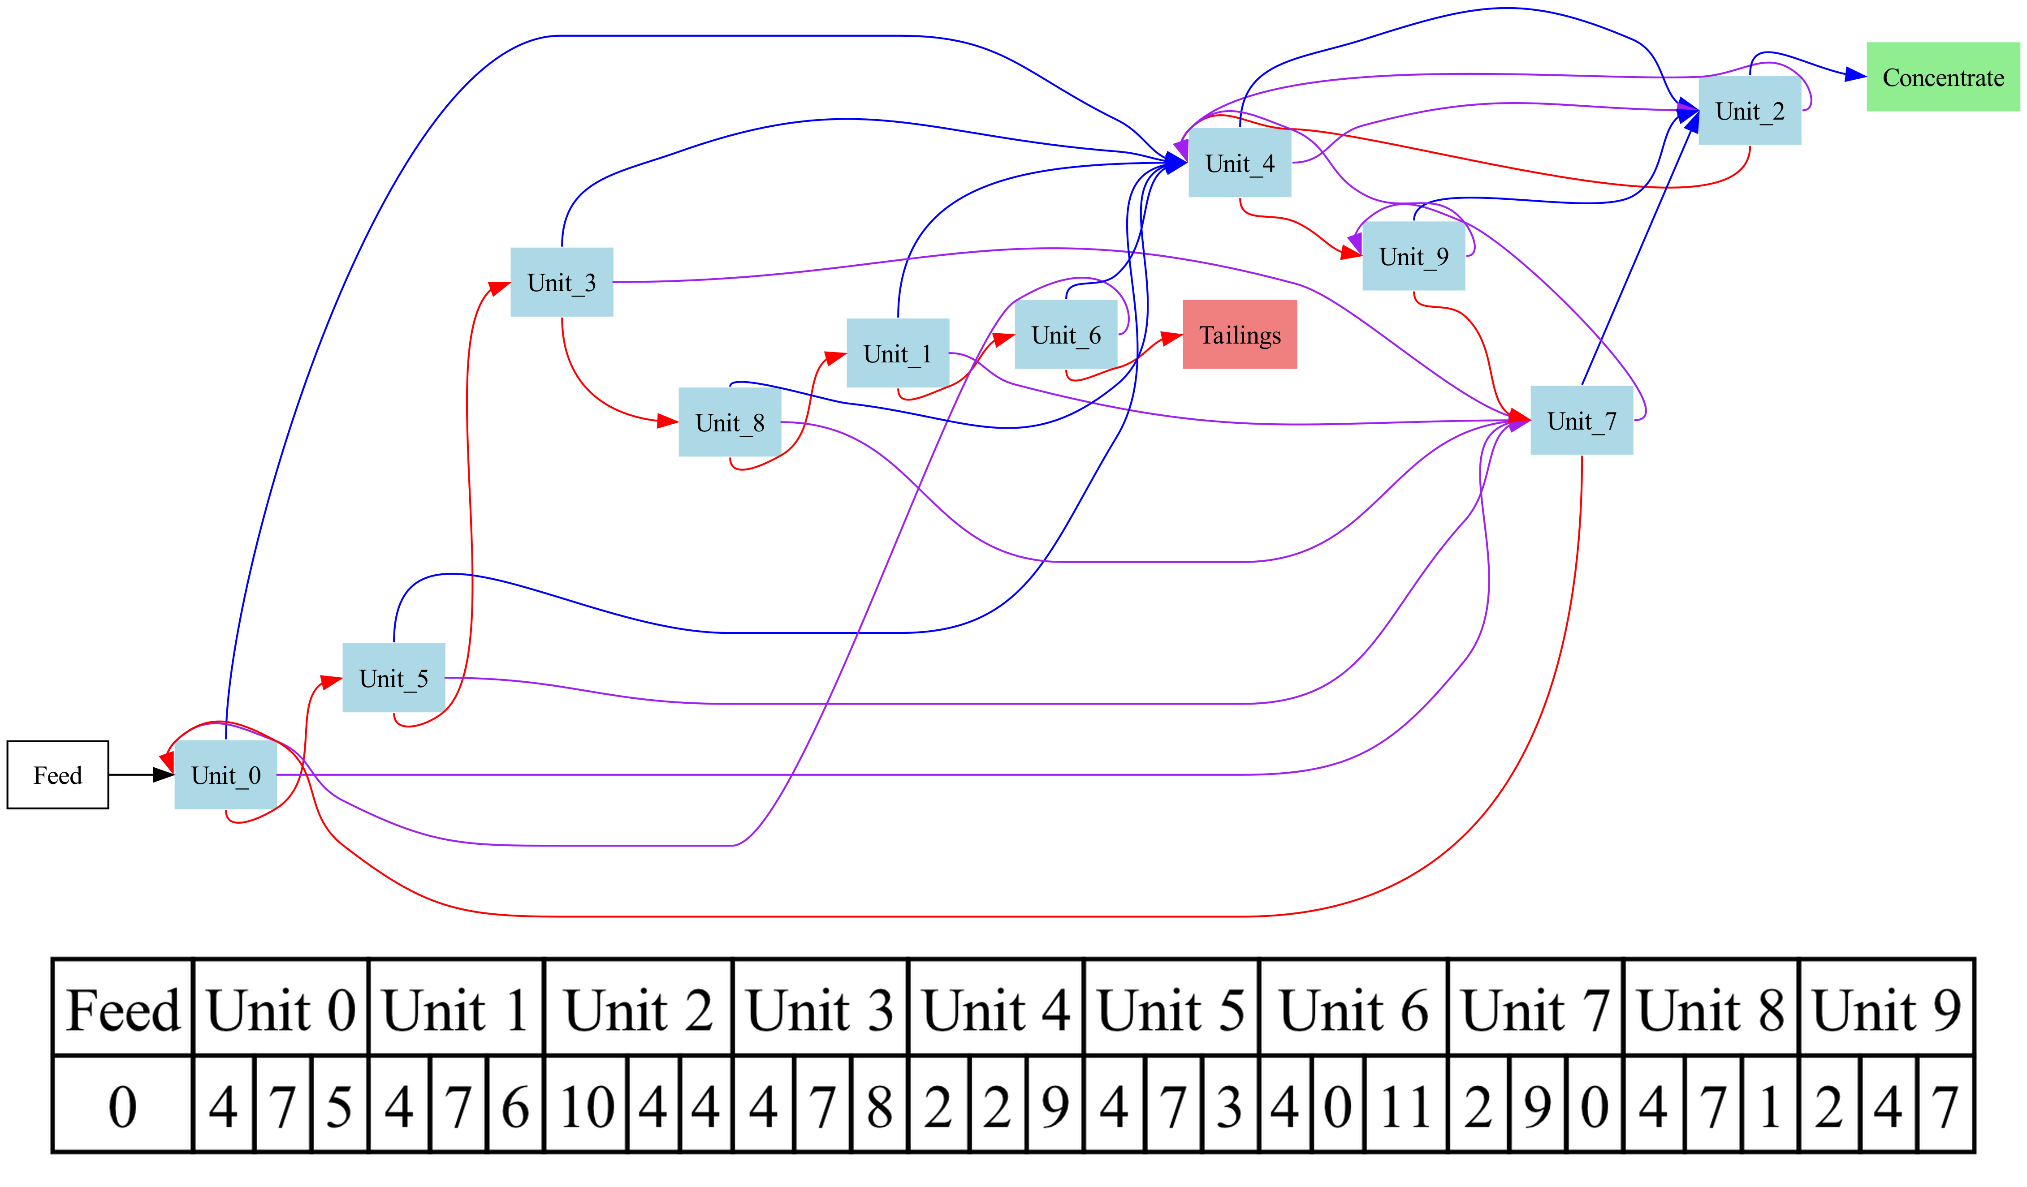
Circuit Modelling
Best circuit with 10 units
Performance: 437.72
Grade 99.05%
Various vectors but the same pattern.

Slide 14
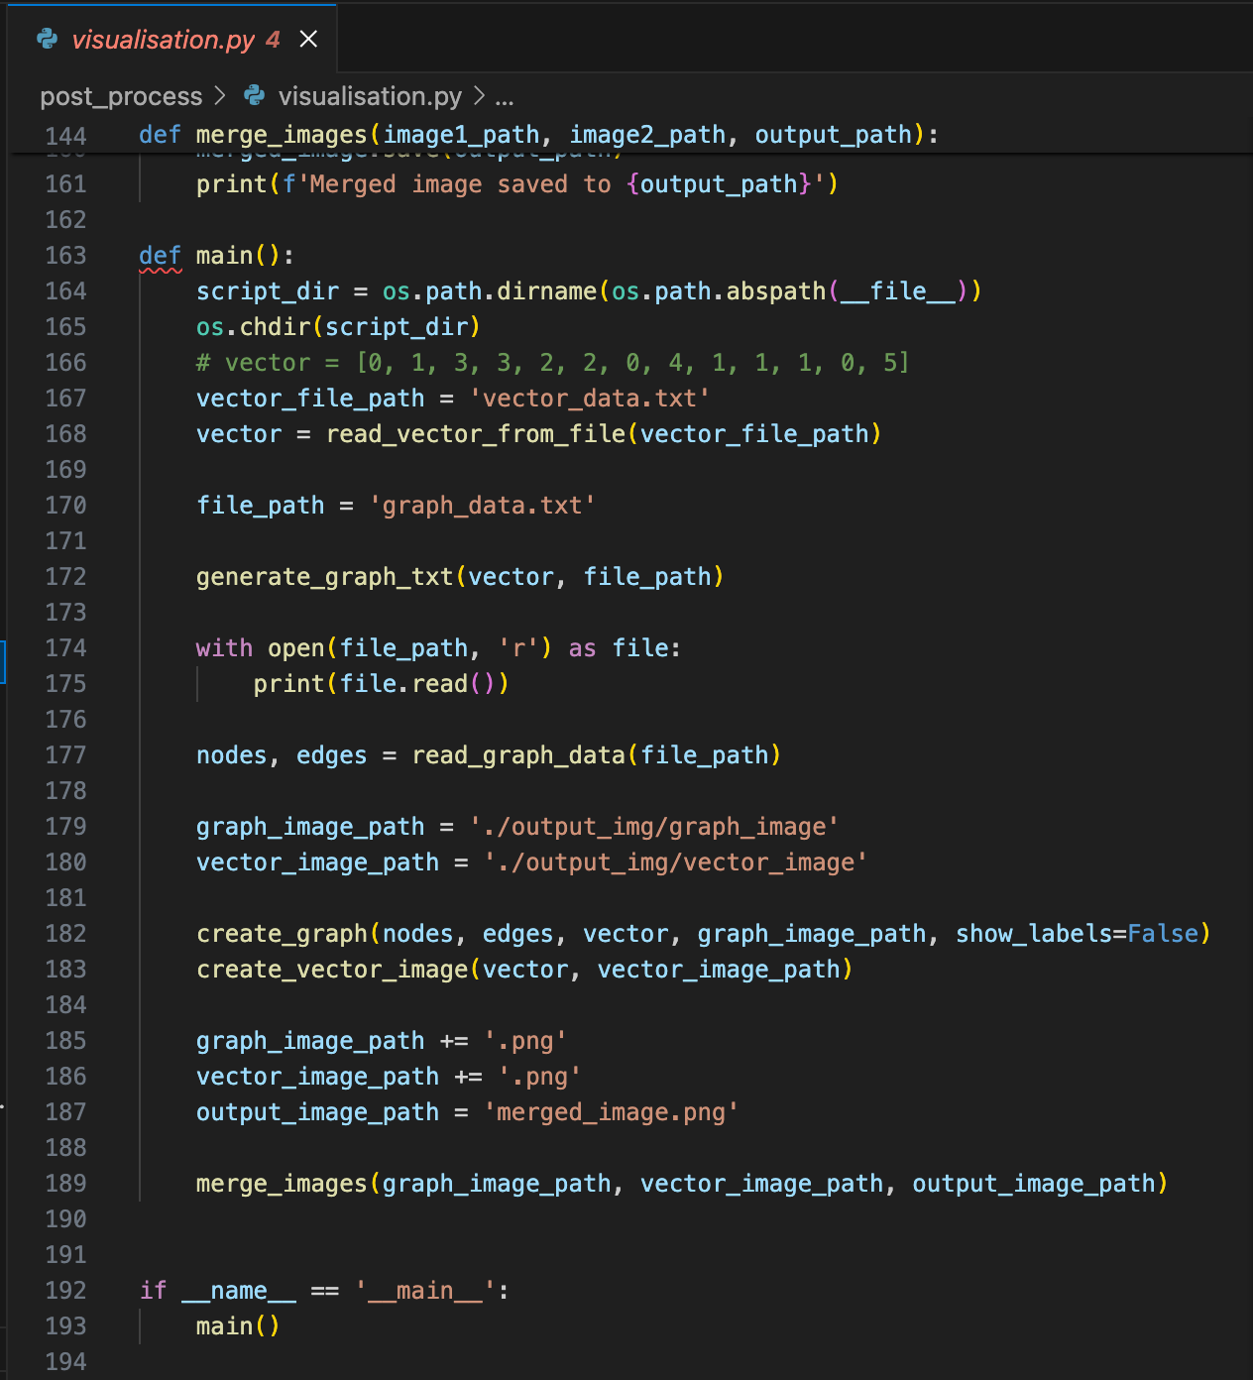
Post-Process
Visualisation
.
├── __init__.py
├── graph_data.txt
├── merged_image.png
├── output_img
│ ├── graph_image.png
│ └── vector_image.png
├── vector_data.txt
└── visualisation.py
post_process
python visualisation.py inside post_process folder
./run_visualisation.sh in the root directory

Slide 15
Model analysis and performance enhancement

Slide 16
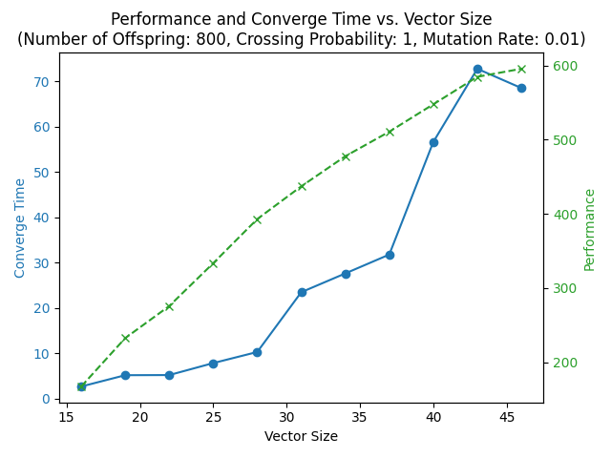
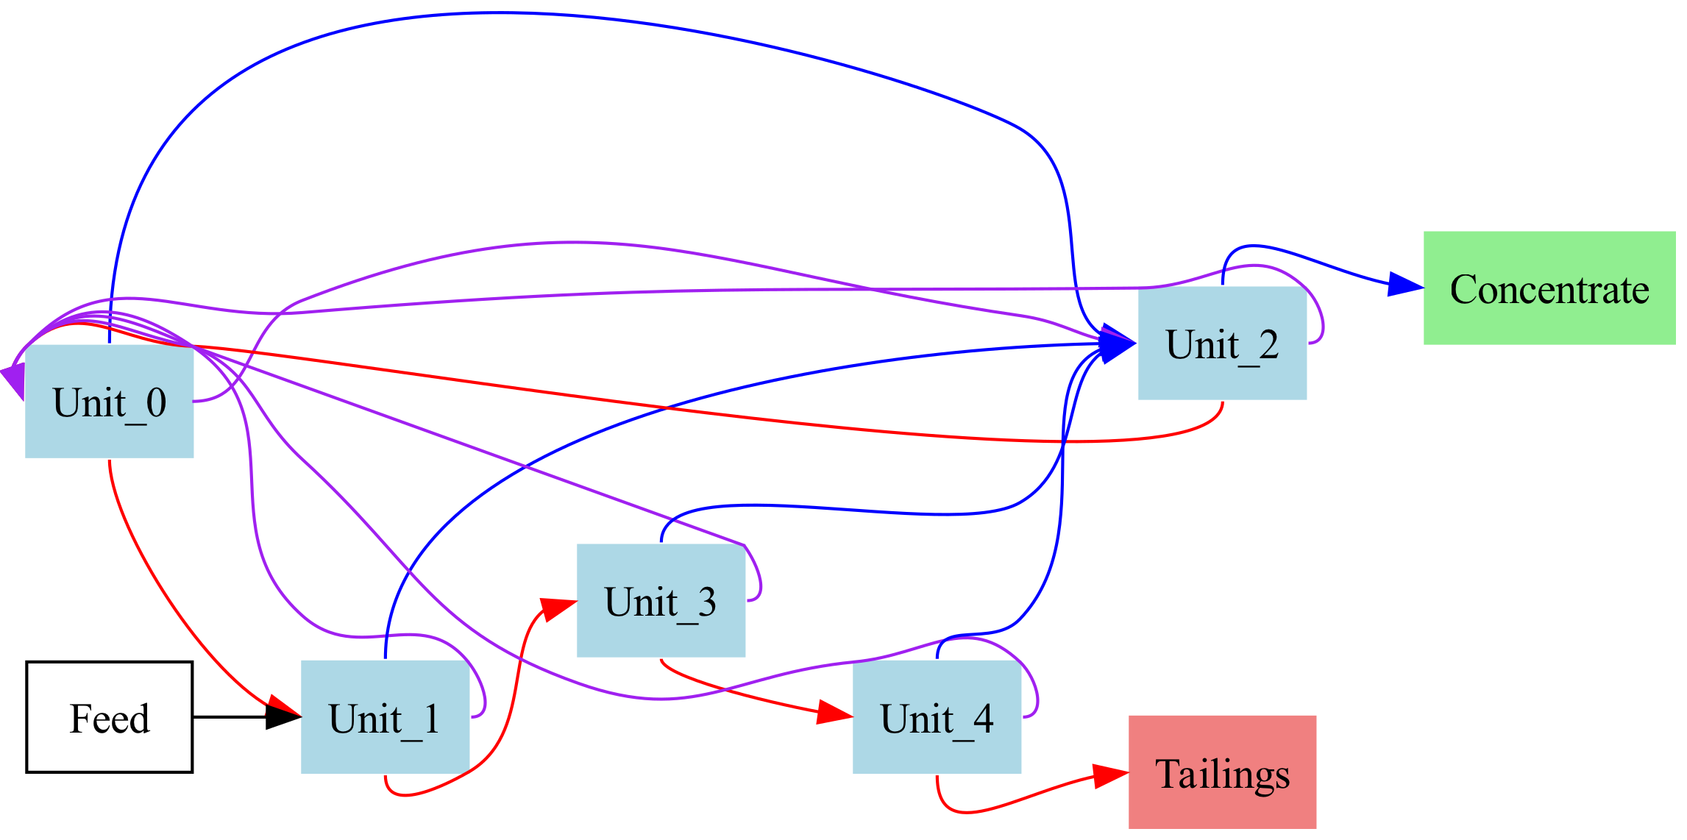
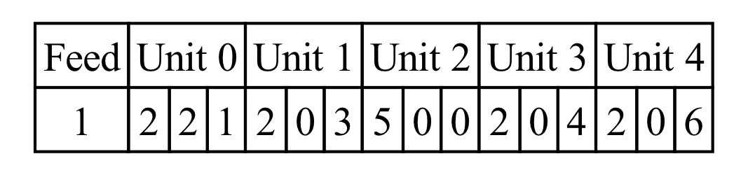
Model analysis
The convergence time is almost proportional to the size of the vectors, but the performance at convergence is unstable. This could mean that the parameters were not set in such a way that the genetic algorithm outputs on the true global optimum when the vectors are large.
When a new benefit function
300 * valuable - 450 * waste
is set, a different permutation is created.

Slide 17
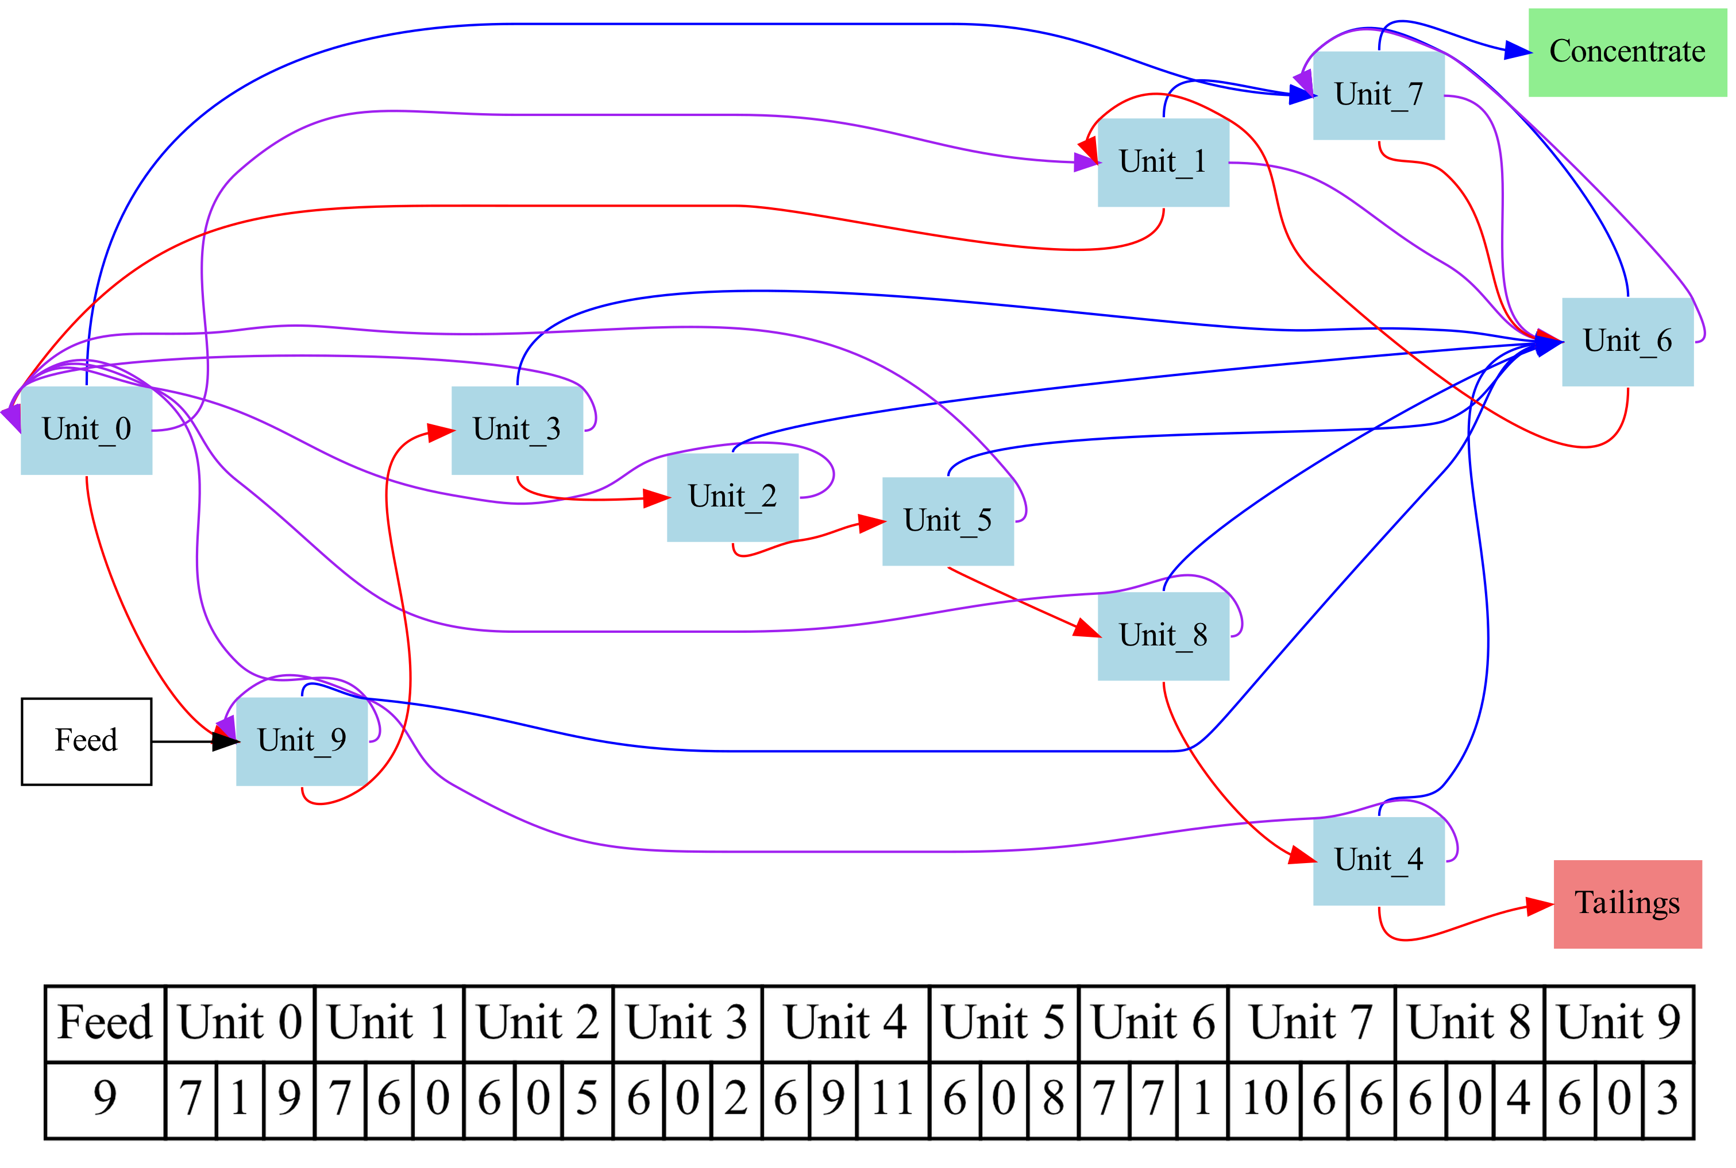
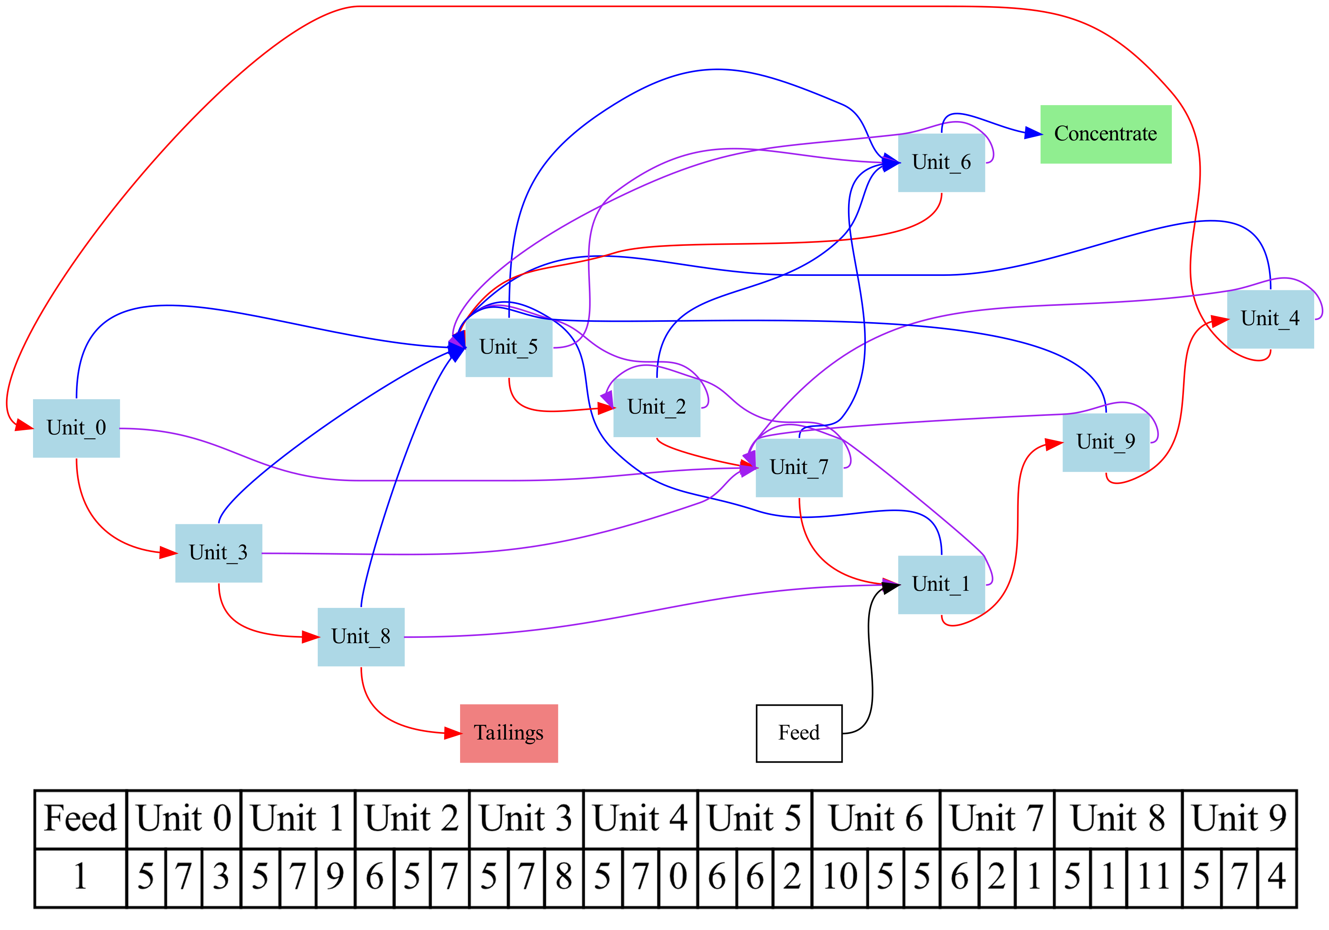
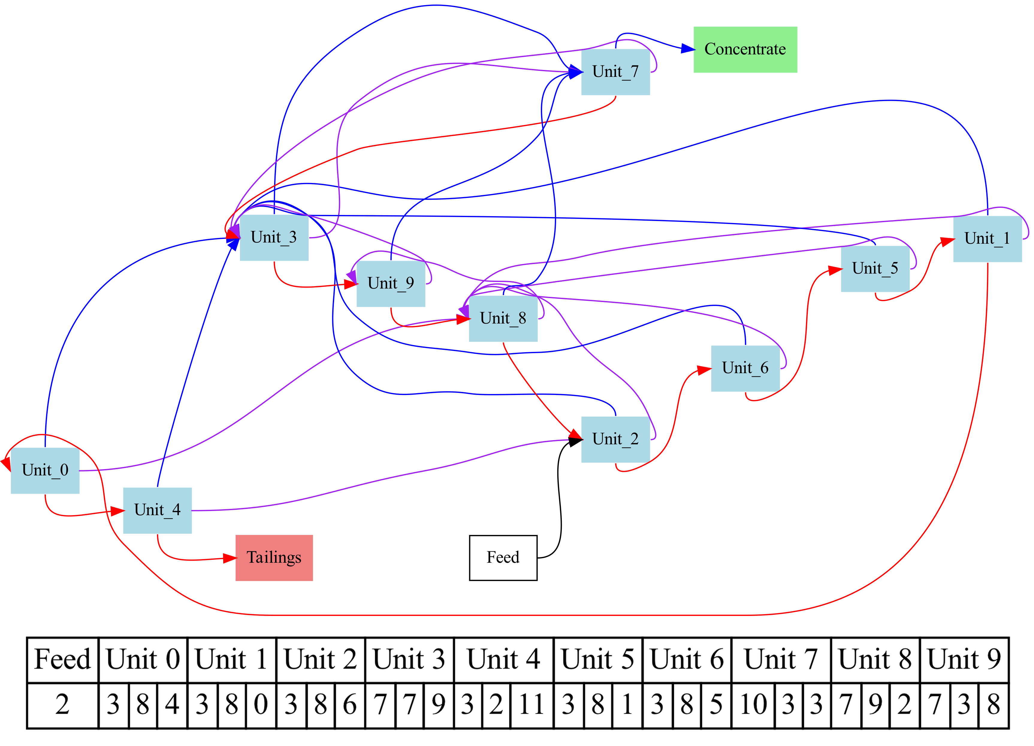
How the optimum circuits change
The price paid for geradium relative to the cost of disposing of the waste material
£100 for every kg of geradium.
£-500 for every kg of waste.
Linear.
Fewer circles.
£100 for every kg of geradium.
£-750 for every kg of waste (default).
£100 for every kg of geradium.
£-1000 for every kg of waste.
Complex.
More circles.

Slide 18
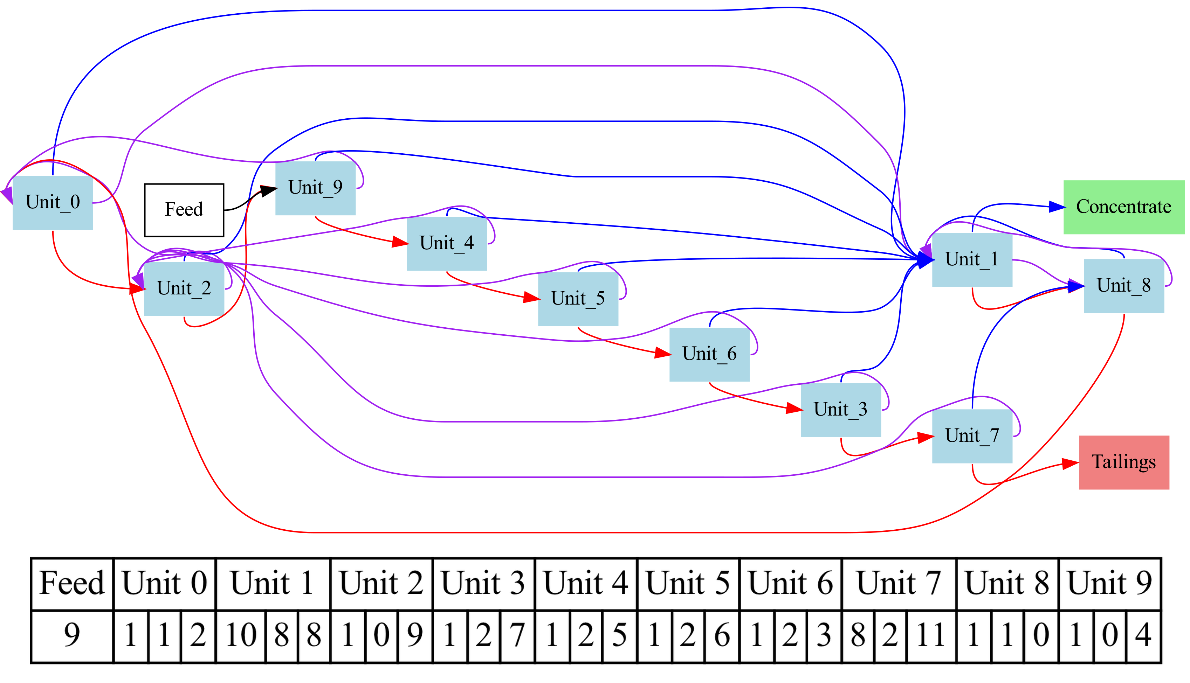
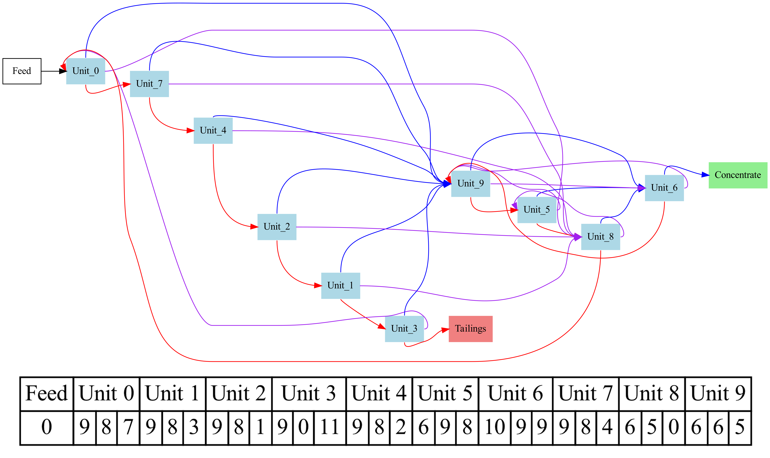
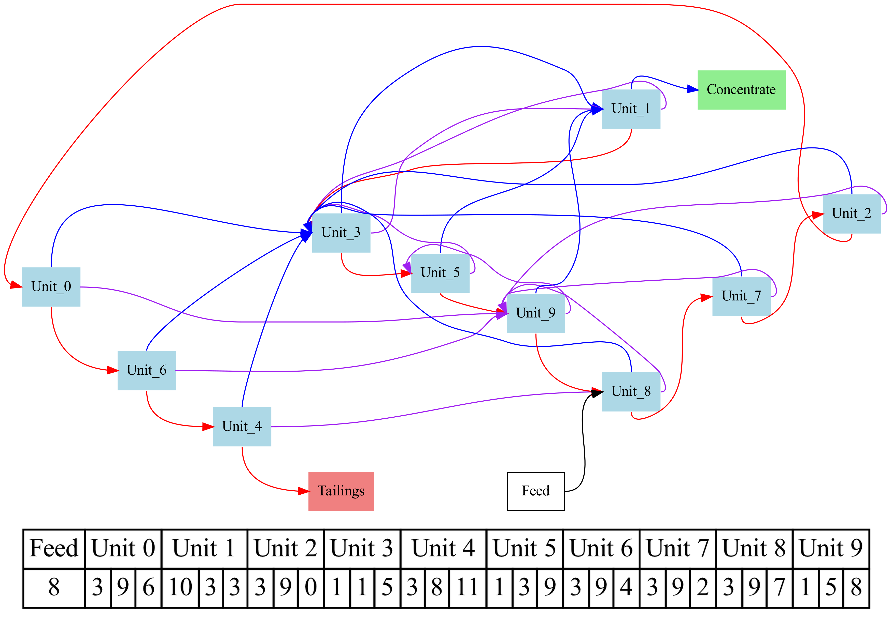

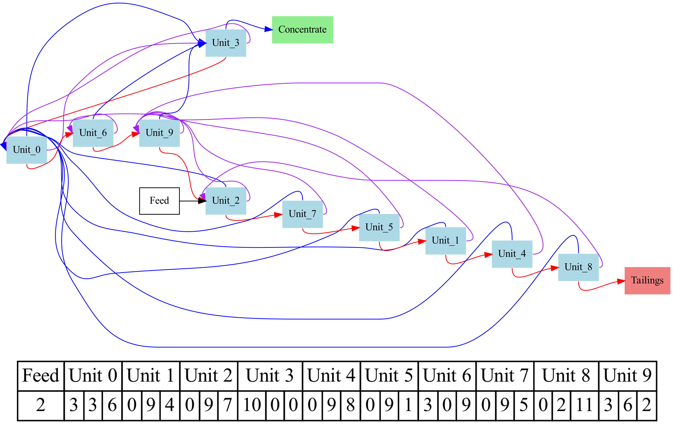
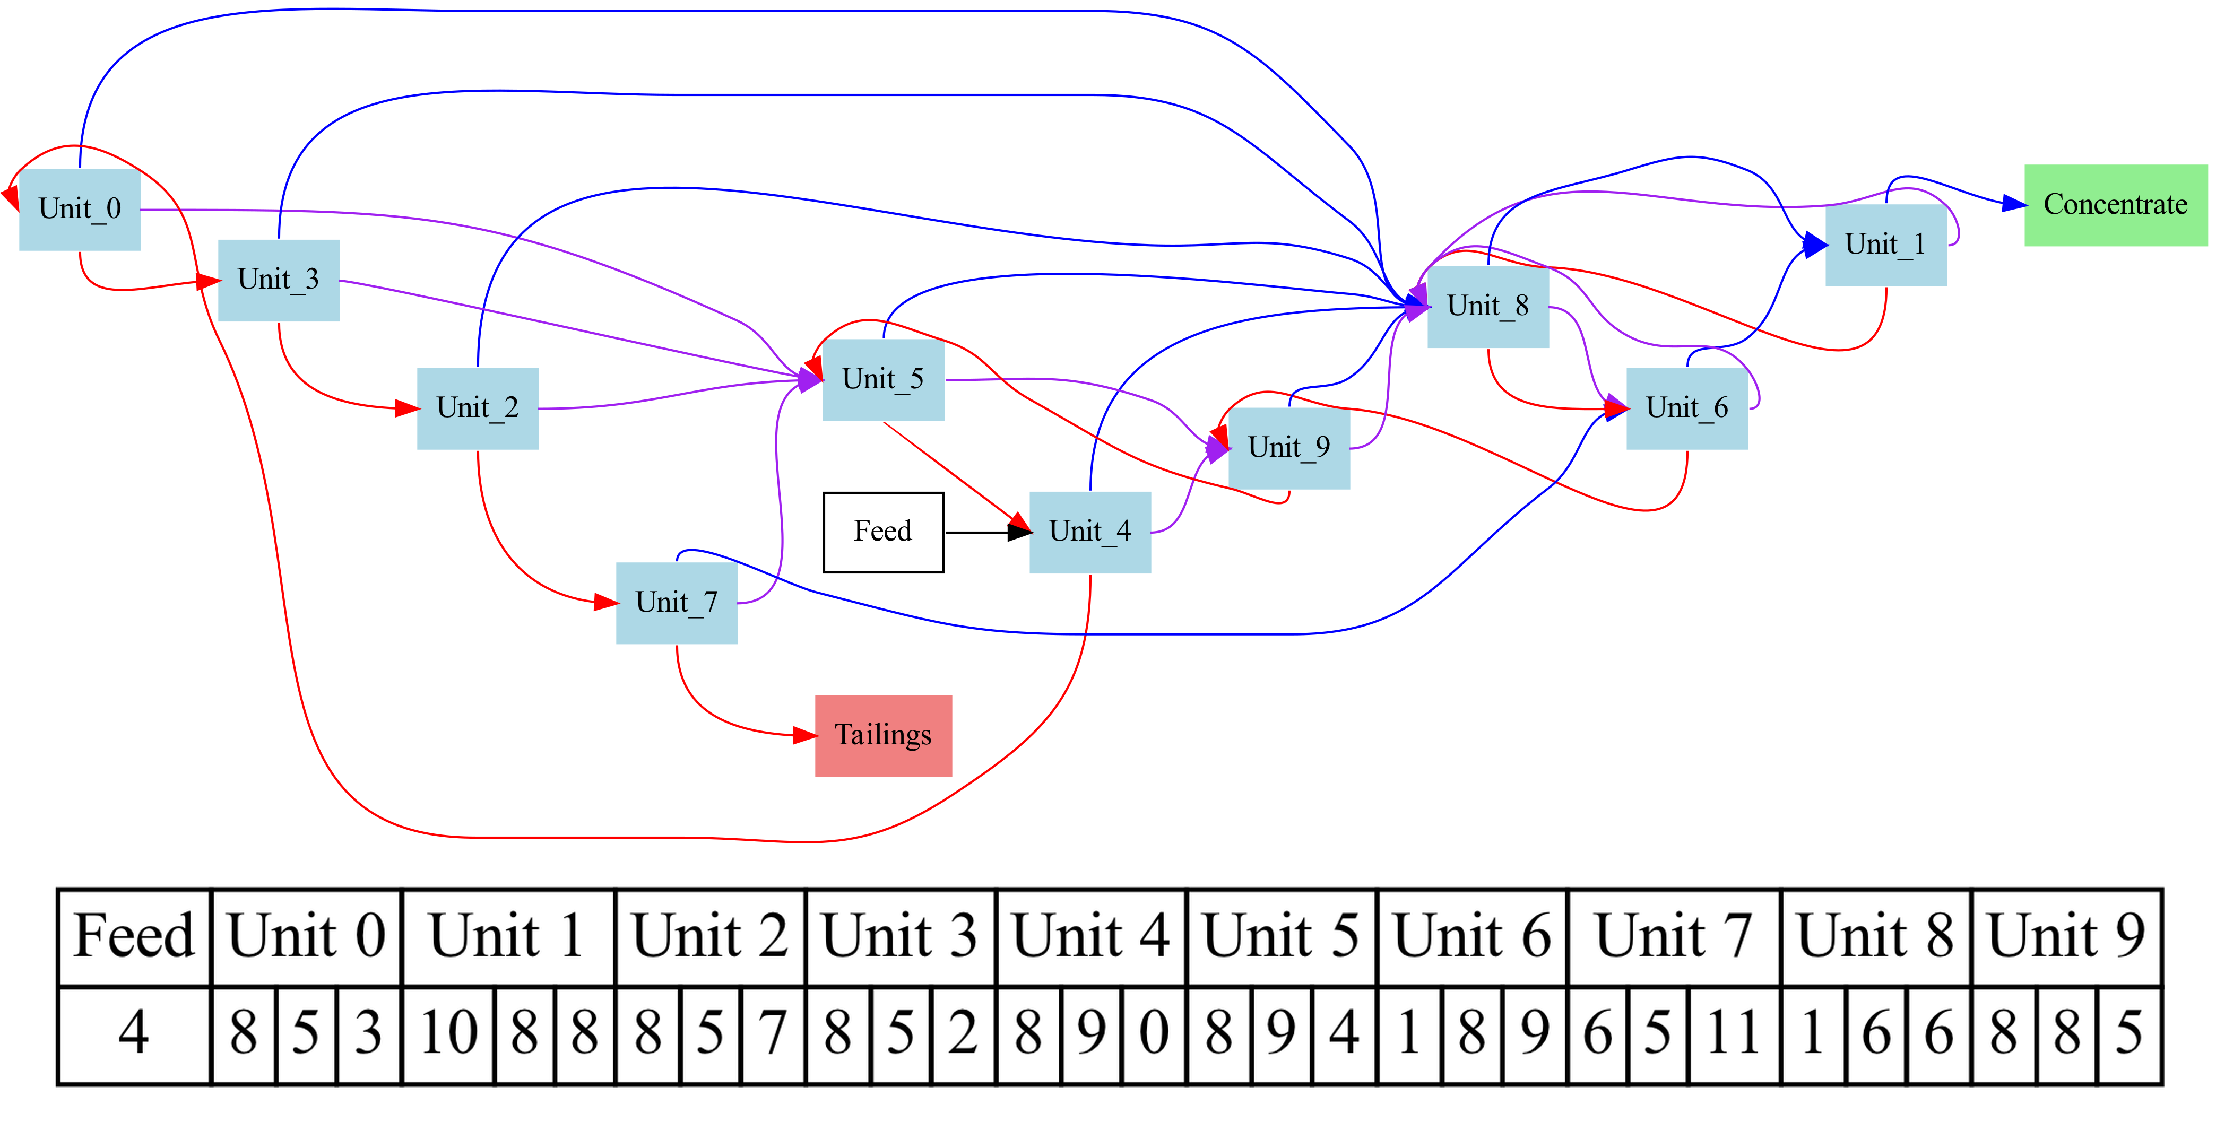
How the optimum circuits change
The price paid for geradium relative to the cost of disposing of the waste material

Slide 19
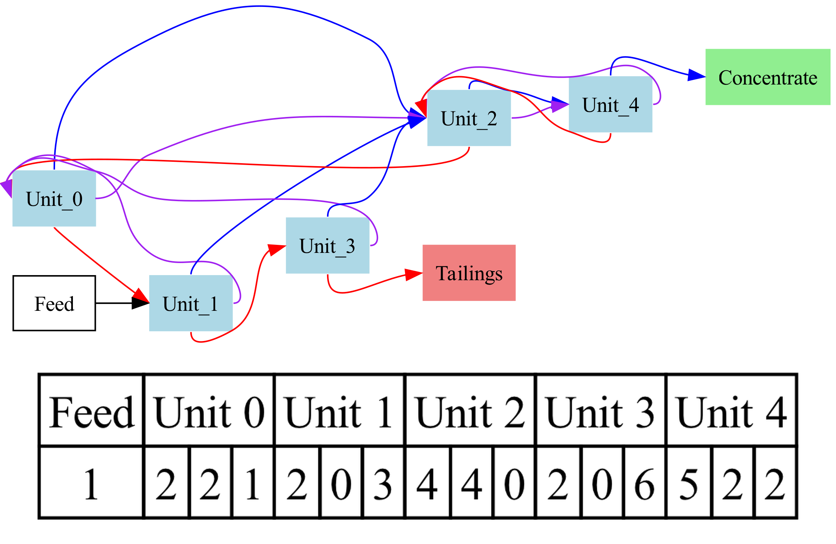
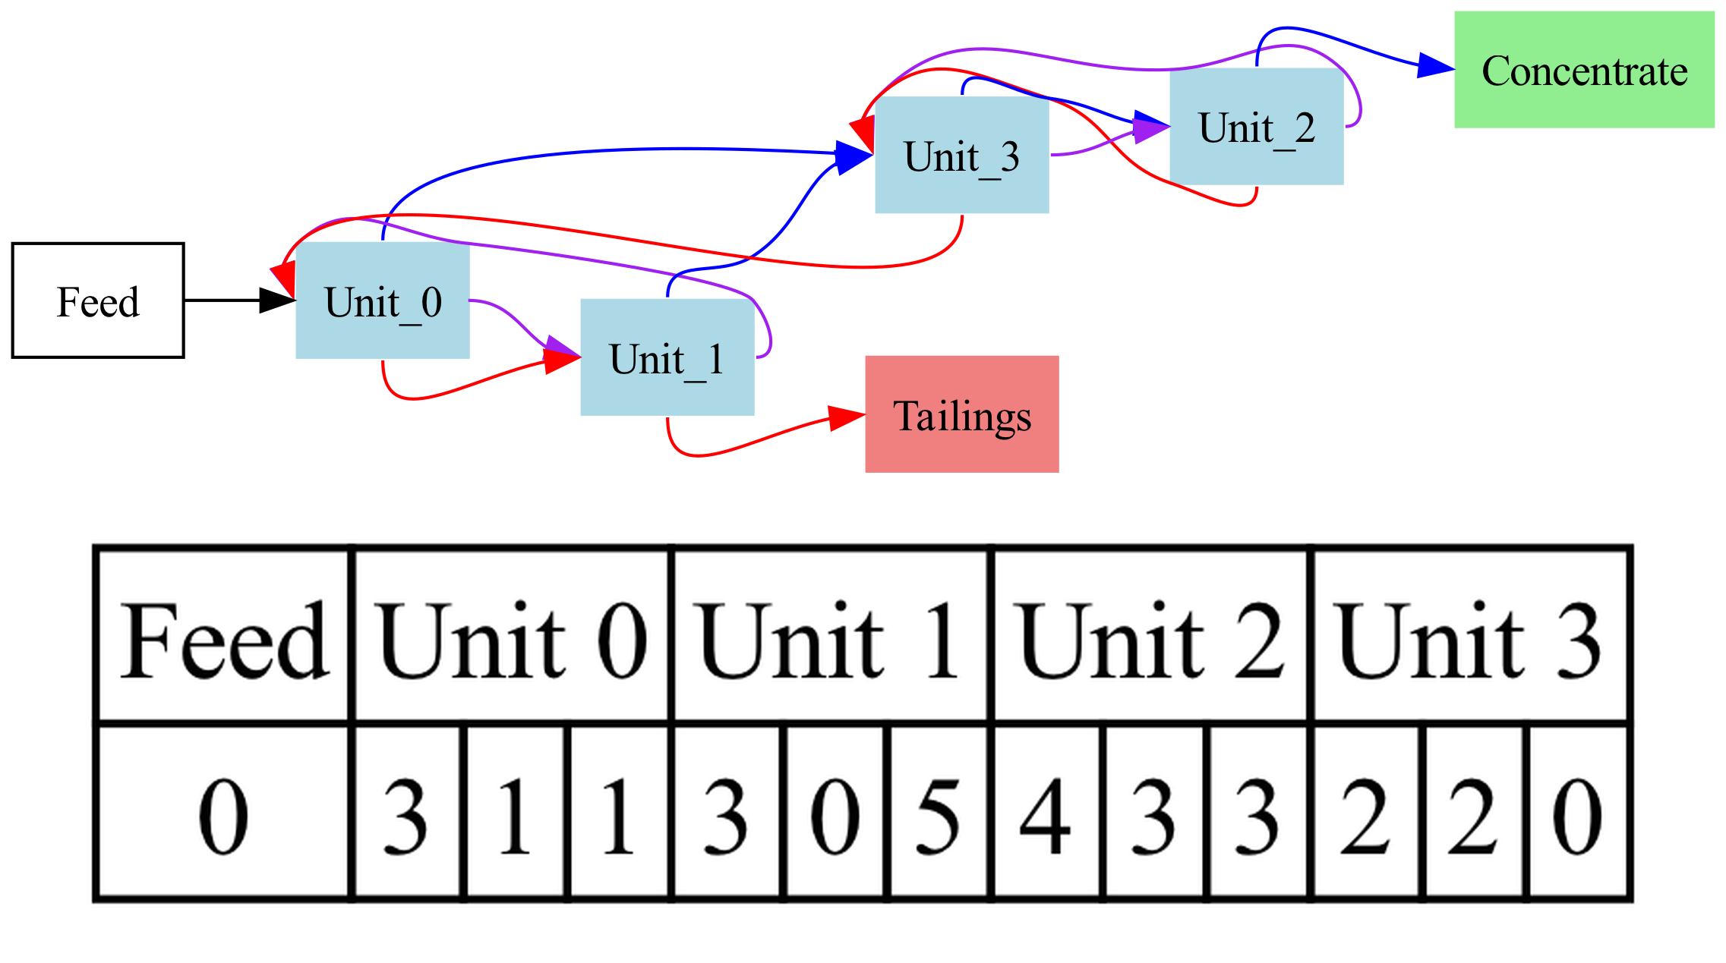
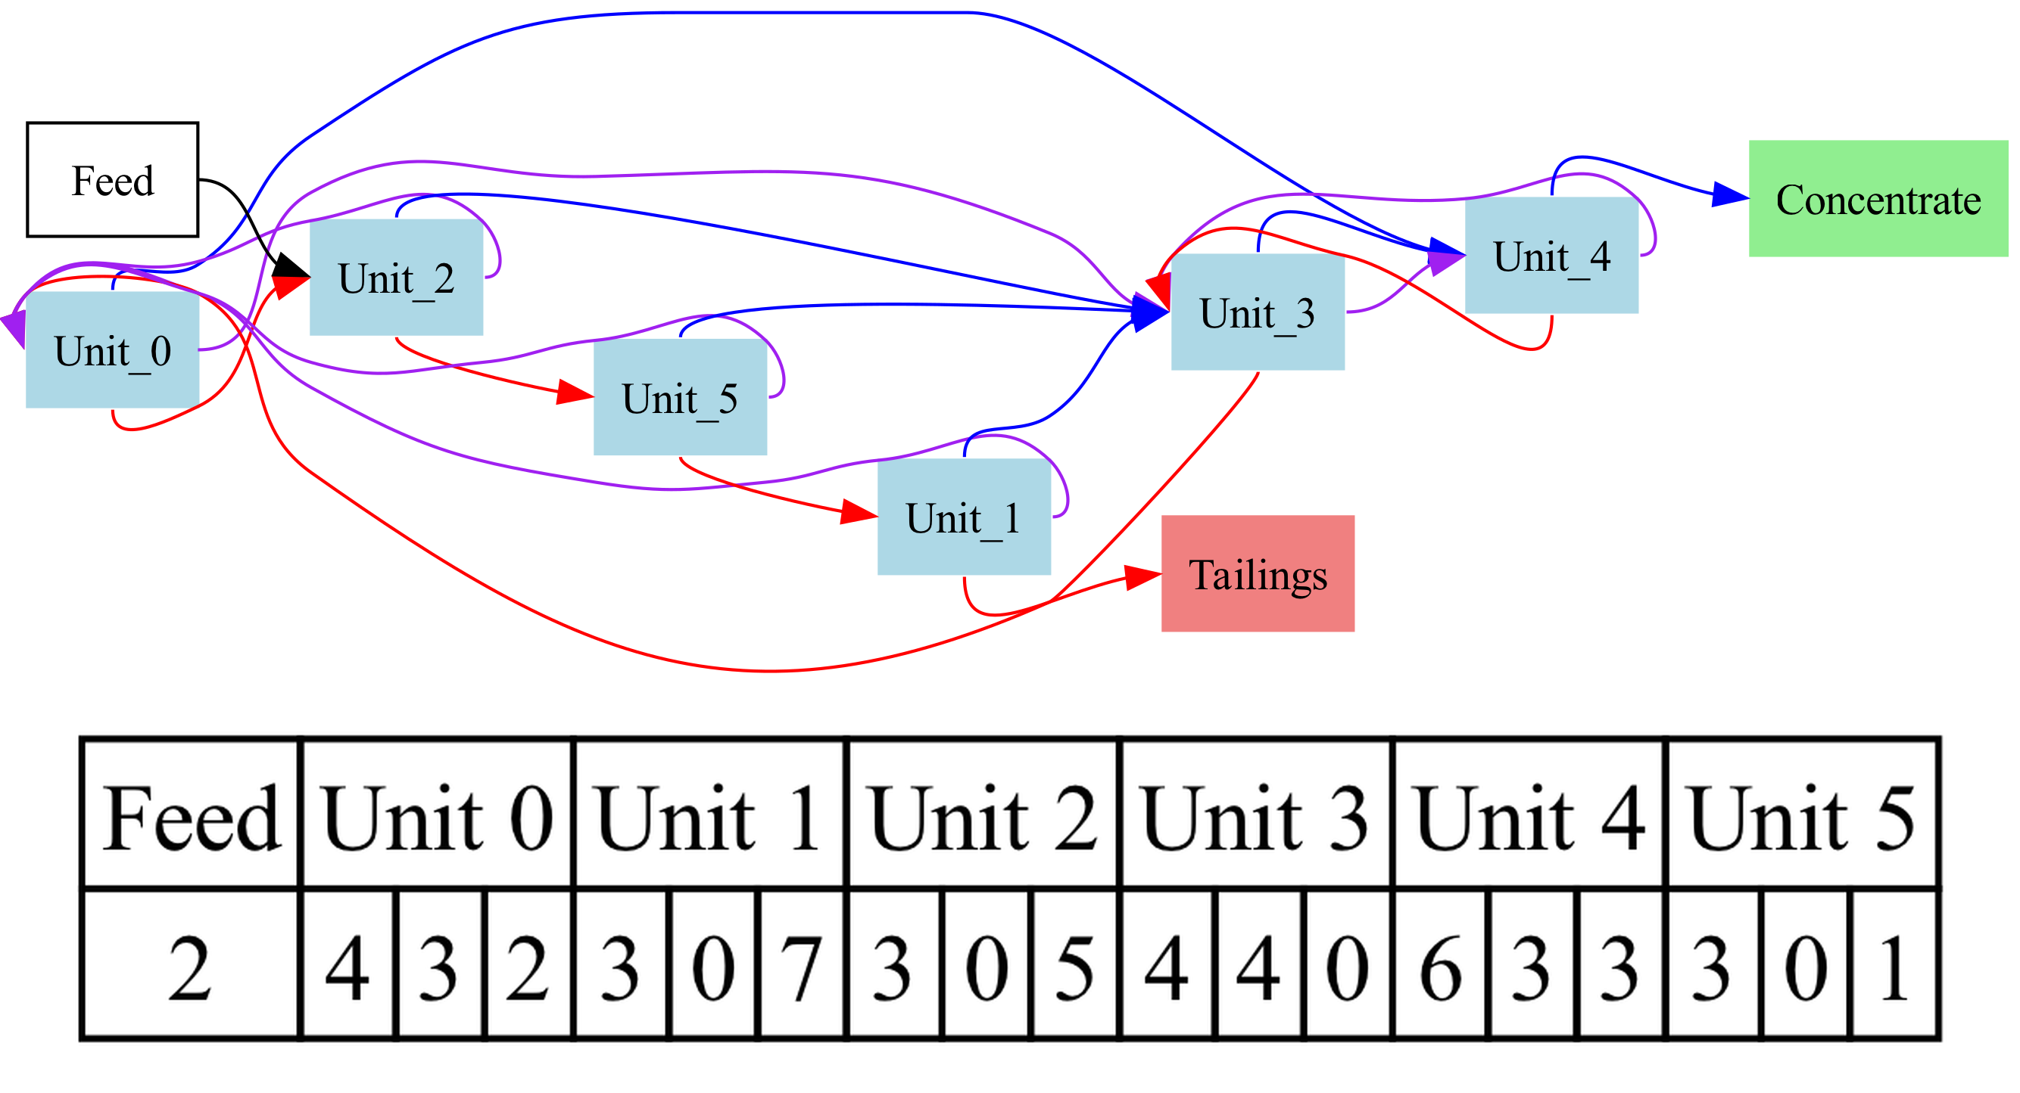
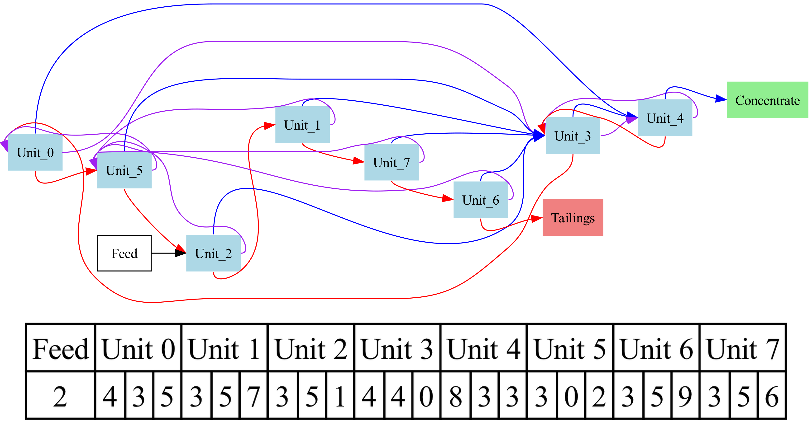
How the optimum circuits change
The number of units

Slide 20
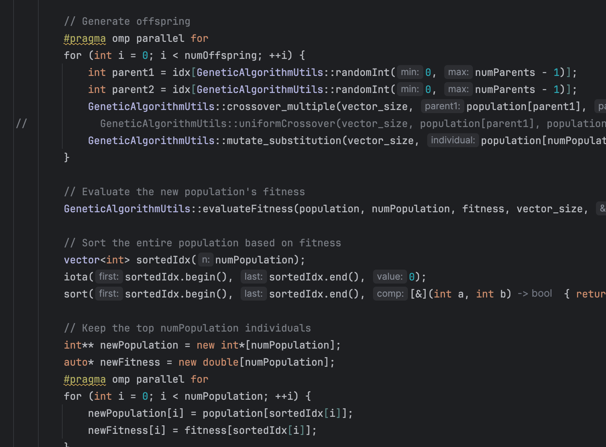
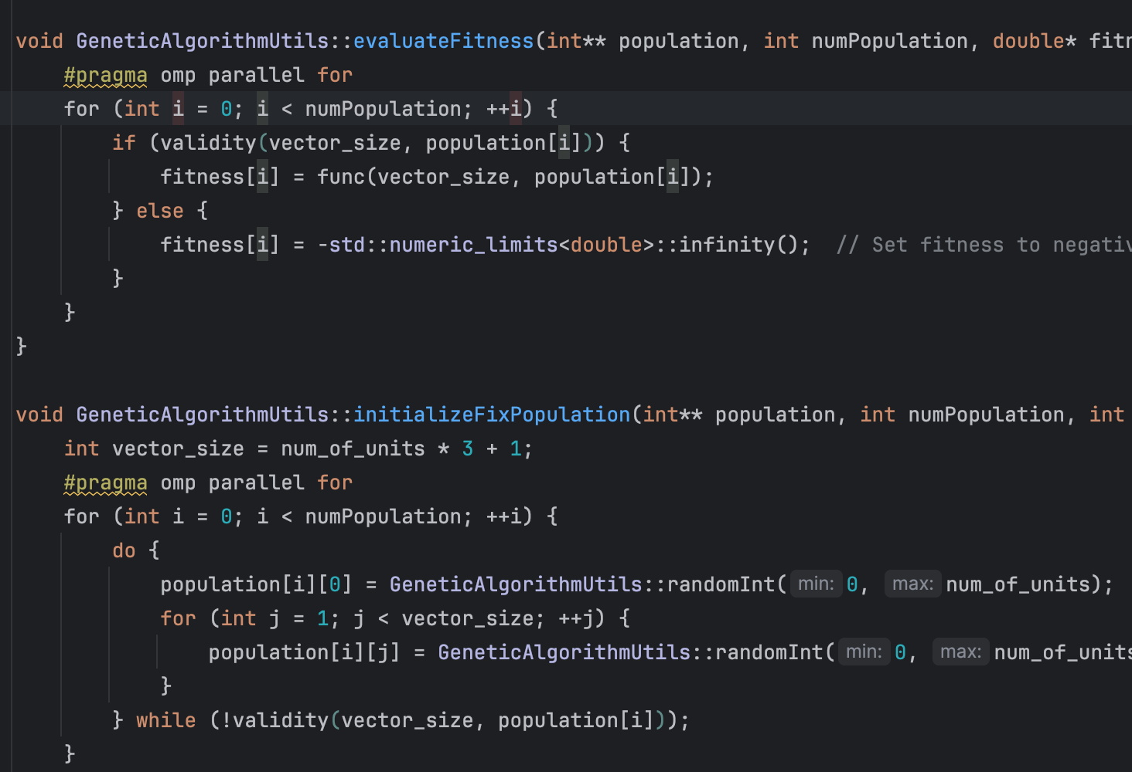
Parallel
The genetic algorithm requires the evaluation of a large number of independent circuit configurations at each iteration.
The serial execution takes long time.
The best way to solve it is to make it parallel.
Focus on the for loops.
Parallel method：
openmp

Slide 21
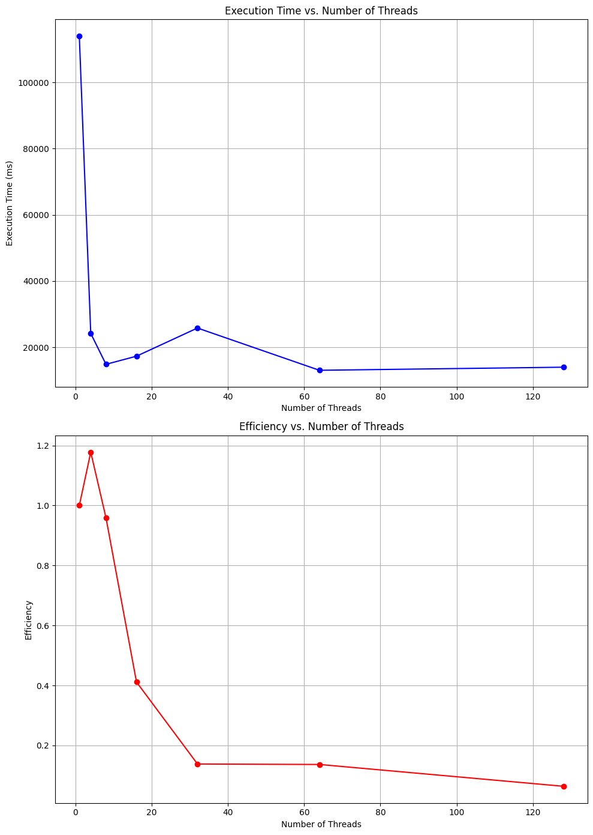
Test 1, 4, 8, 16, 32, 64, 128 threads in hpc.
It is clear that parallel significantly increases the efficiency.
However, as the number of threads increases, the efficiency becomes lower.

Slide 22
Further improvements
Population Initialization : Optimize population initialization.
Combine Crossover methods : Benefit from different methods strengths in single run
Parallelization: Switch from Openmp to MPI.
Dynamic Interface Addition : Interactive parameter adjustments and Real-time monitoring of algorithm progress.

